Slide 1



Breakdown the Black Magic of Cilium
Aldin Setiawan
Majutsu engineering

Slide 2
Disclaimer
Open discussion.
There is no vendor comparison.

Slide 3
AGENDA
Section
Part 1
Problem
00
Cilium CNI?
01
The Journey of netfilter
02
Breakdown the Black magic of Cilium
03

Slide 4



Problem
Research
Deploying
Our team have problem with High Latency in k8s
Find alternative CNI or Tuning mumbo jumbo(?)
Solve the step 1 or back to step 1

Slide 5
The Problem
Big latency between service
Often get “connection reset by peer”
Another latency

Slide 6

Research
One of our wizard tech recommend us to try Cilium
No one ask “why cilium” because the wizard already spoken
Tbh I little skeptic about his whisper, as far as i know k8s CNI is only about Tunneling or Routing

Slide 7
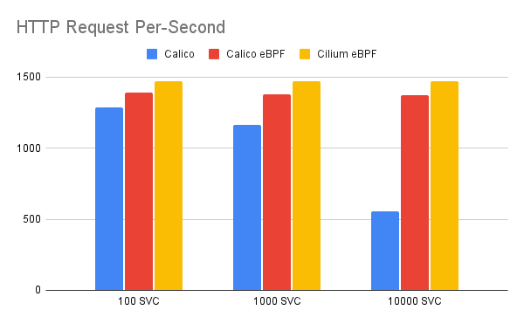
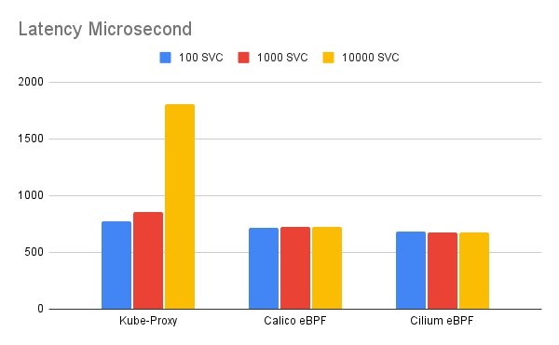
Research Result
Higher is better
Lower is better
Credit research @Jhody Sekardono

Slide 8

Research Result
My honest reaction
What Magic is this!?

Slide 9
Cilium CNI
Cilium CNI is a powerful networking plugin for Kubernetes which provides enhanced security and networking capabilities for containerised applications. It leverages the power of eBPF (extended Berkeley Packet Filter), a highly efficient and programmable kernel-level technology, to deliver transparent network security and traffic monitoring features.

Slide 10
eBPF
eBPF technology actually pretty old(1992) and already
exists long time ago, the original of eBPF is Berkeley Packet
Filter(BPF) or originally for packet filtering (tcpdump), eBPF has evolved into a versatile framework for observing and extending kernel behavior without requiring custom kernel modules
tl;dr
Think of eBPF as the "secret sauce" for Linux. It’s like that one app that can do literally everything, but instead of just running on your phone, it’s vibing straight in the kernel (the brain of the operating system). 💡🔥🔥🔥

Slide 11

“the packet should be filtered ‘in place’ (e.g.,where the network interface DMA engine put it)”

Slide 12

eBPF
Why package filter technology can solve latency issues?
What the correlation between app inside kernel with cni?
Why other cni look more slow than cilium?
is mayonnaise an instrument?

Slide 13

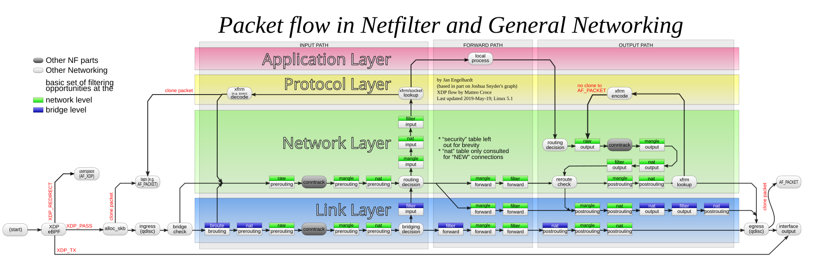
Iptables, our lovely tools
Over the years, iptables has been a blessing and a curse: a blessing for its flexibility and quick fixes. A curse during times debugging a 5K rules iptables setup in an environment where multiple system components are fighting over who gets to install what iptables rules. (cilium blog)

Slide 14

Iptables, our lovely tools
Iptables incompatible with many rule, i.e when doing scale up/down pod iptables will rewrite entire rule or when pod communication to svc they will create many conntrack
“Iptables-save” in kube worker prod

Slide 15
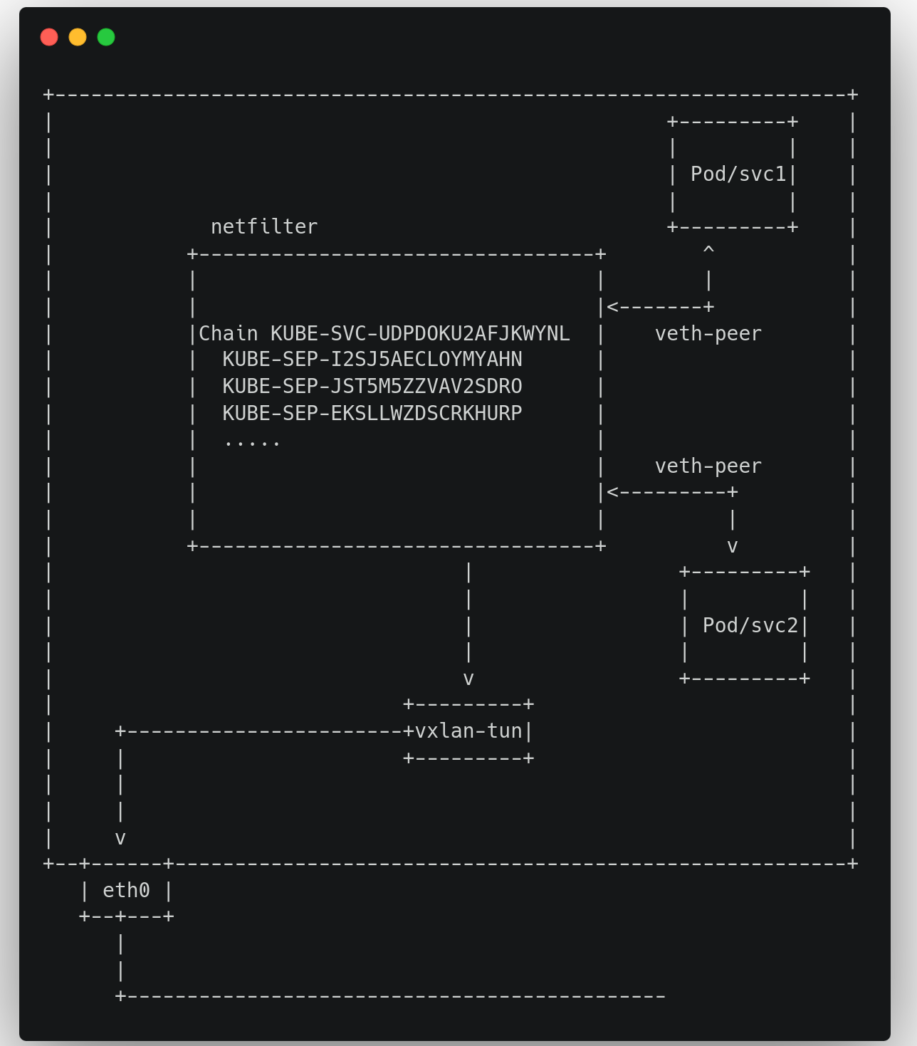
Too much yapping, show the rizz 🗣️🗣️🗣️
Let’s tap the veth-peer interface with tcpdump to see the pkt
Count the linux conntrack

Slide 16

Too much yapping, show the rizz 🗣️🗣️🗣️
curl 'https://asciinema.humanz.moe/a/MqiMLpfEdYW0hsIgnqXNOwkMF.cast?dl=1'\
-o /tmp/cast1;asciinema play /tmp/cast1

Slide 17
Too much yapping, show the rizz 🗣️🗣️🗣️
First pkt was send through veth peer interface into netfiter with dst cluster ip
When pkt arrive in netfilter pkt will be load balancing(dnat) and trigger the conntrack

Slide 18

Ready to Breakdown the Black magic of Cilium?
Since we already know the downside of iptables now let’s move into Cilium

Slide 19
Bro is Cooking 🗣️🔥🔥🔥
curl 'https://asciinema.humanz.moe/a/bC0KPiKnfNpDKu4QShHdfLTic.cast?dl=1'\
-o /tmp/cast2;asciinema play /tmp/cast2

Slide 20
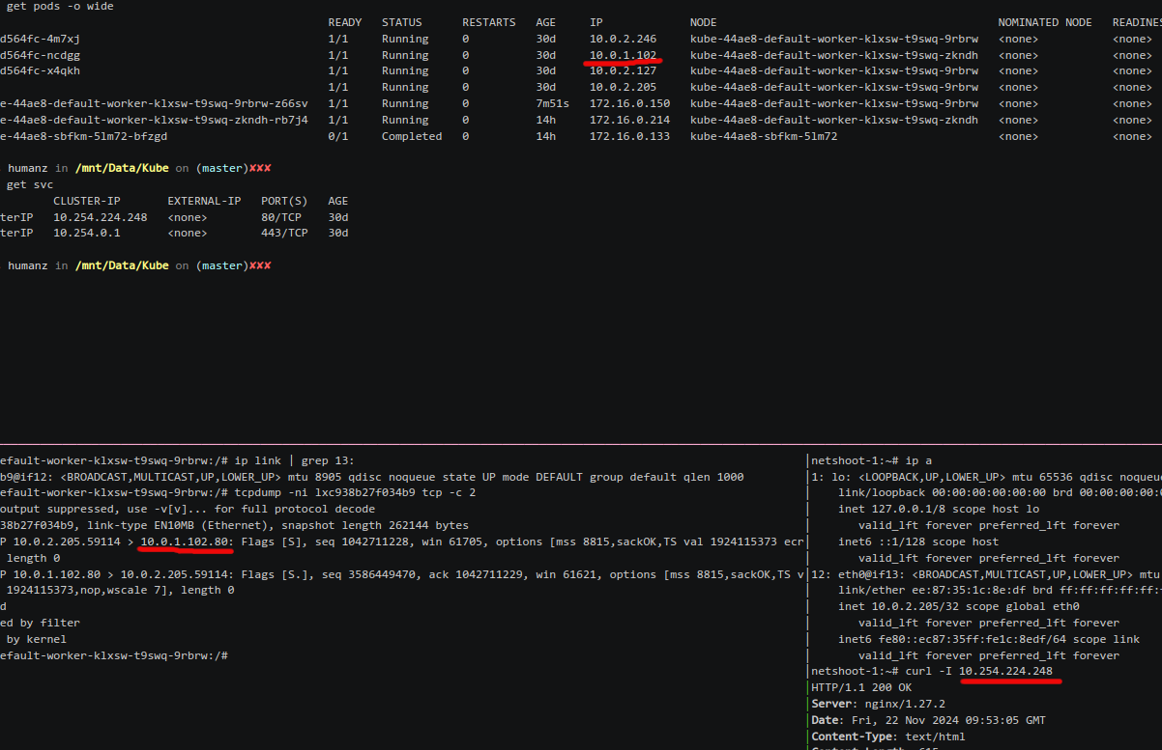
Bro is Cooking 🗣️🔥🔥🔥
Here was the ebpf action, when the pkt move into netfilter the dst already changed into pod ip

Slide 21
Bro is Cooking 🗣️🔥🔥🔥
The dst of pkt already translate into pod ip
But how that possible?

Slide 22
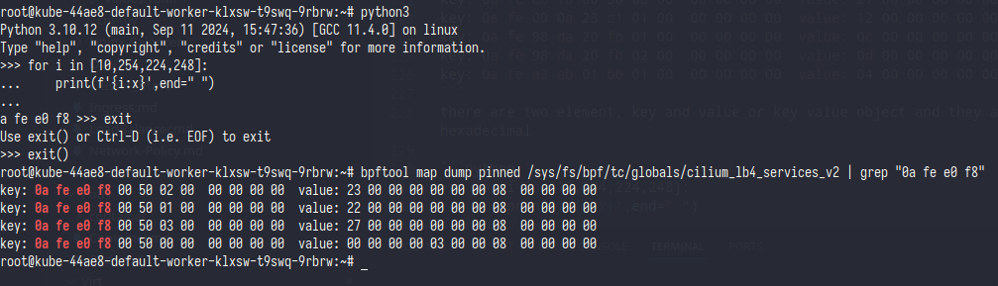

Bro is Cooking 🗣️🔥🔥🔥
All key value in eBPF was written in hex format so we need to convert svc ip into hex

Slide 23
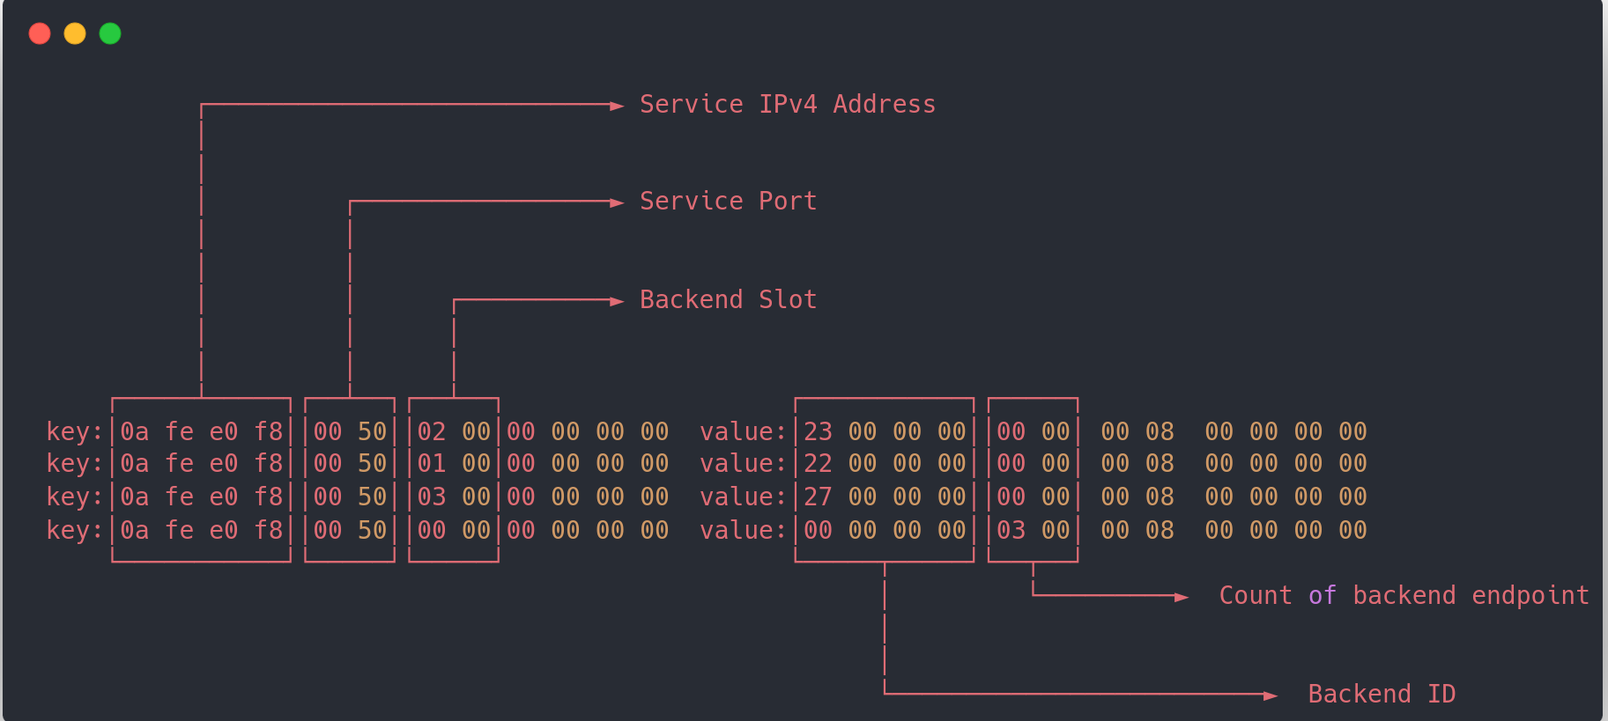
Bro is Cooking 🗣️🔥🔥🔥
According judgment of Oratrice Mecanique d'Analyse Cardinale to cilium source code you can see the ebpf map have struct like this

Slide 24
Bro is Cooking 🗣️🔥🔥🔥
Now the last part is to understand how cilium create a load balancer only from ebpf map

Slide 25
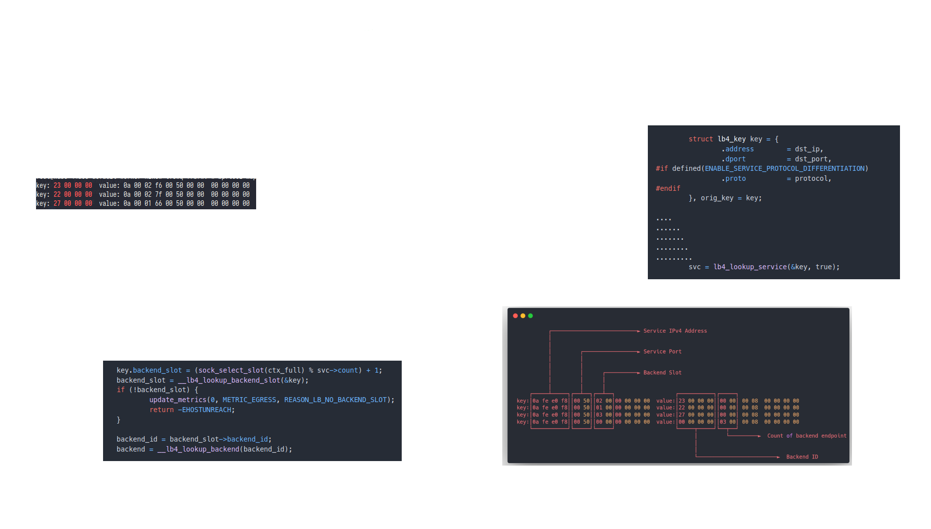
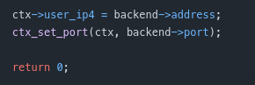
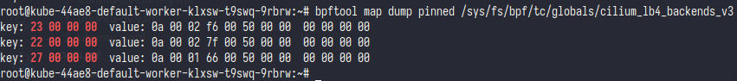
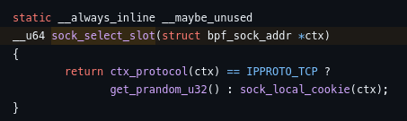
Bro is Cooking 🗣️🔥🔥🔥
￼
1
4
3
2

Slide 26
Bro is Cooking 🗣️🔥🔥🔥
When and Where the eBPF change the pkt?

Slide 27
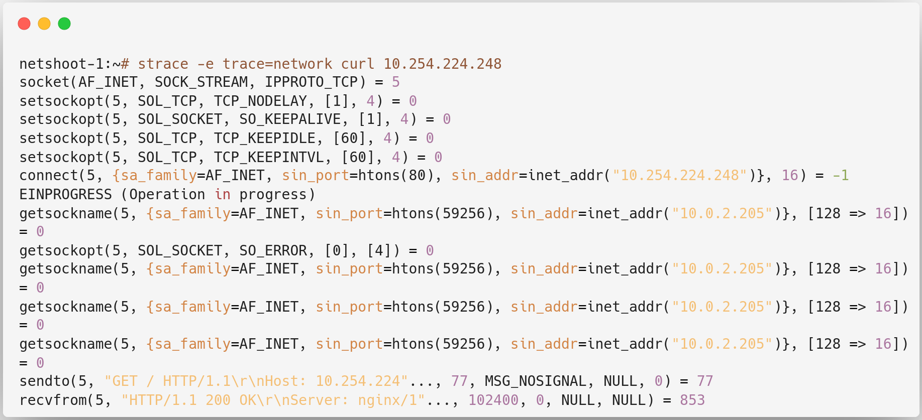
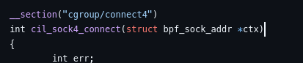
Bro is Cooking 🗣️🔥🔥🔥
If it on kernel then syscall manage it

Slide 28

Phew that’s a lot, any question?

